Slide 1

Venue-Based Similarity Measures in East Central London and Birmingham
By Arkaan Quanunga

Slide 2
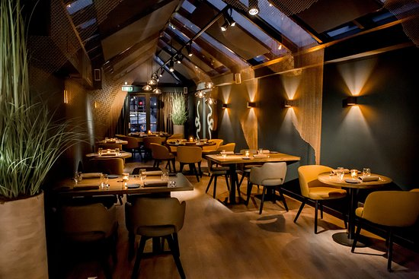

Application of research
Increasing revenue and profit margins for existing and new opening restaurants, locale and Hotels by looking at placements of competitions.
Civil Engineers and political parties look at inside city data to pick optimum location for expanding residential life and provide residents with everyday needs
Comparison of Postcode area districts is important when moving from city to city.
Job seeker can narrow down application of jobs to areas where its particular skillset is highly valued.

Slide 3
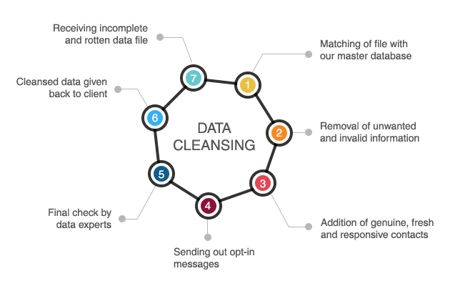
DATA Cleaning
Initial data set of East Central London and Birmingham both obtained from Office of National Statistics
East Central London data with shape (30,4) and Birmingham data shape ( 78,4) was reduced to (25,4) and (37,4) respectively.
Removing non-geographic post codes as well as postcode area districts which are not in Birmingham city were removed.

Slide 4

Application programming interface(API)
Geolocator API
Geocoder API
Foursquare API

Slide 5
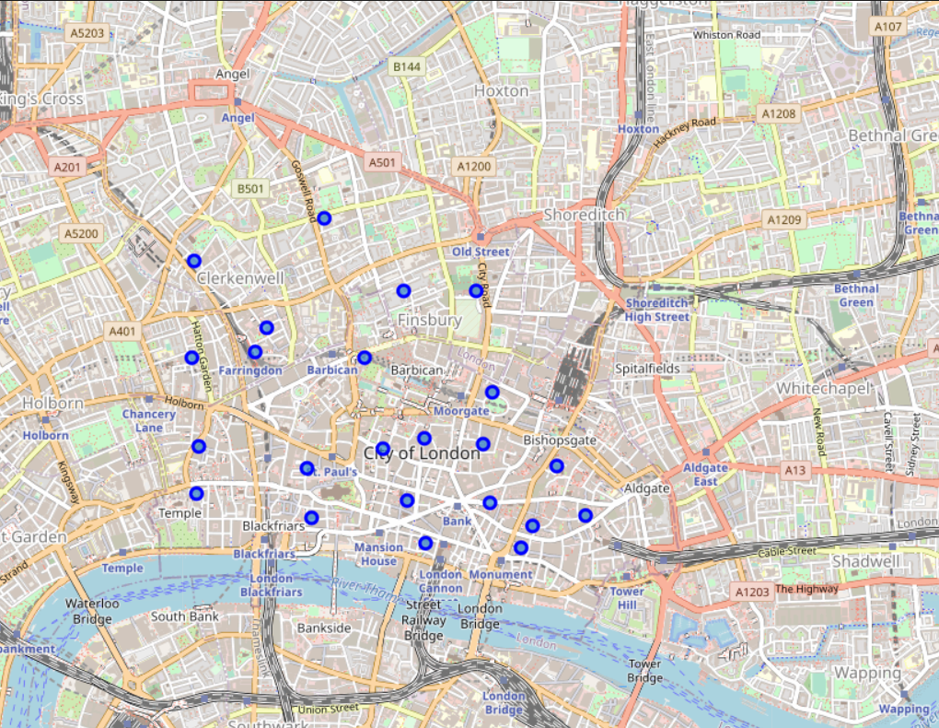
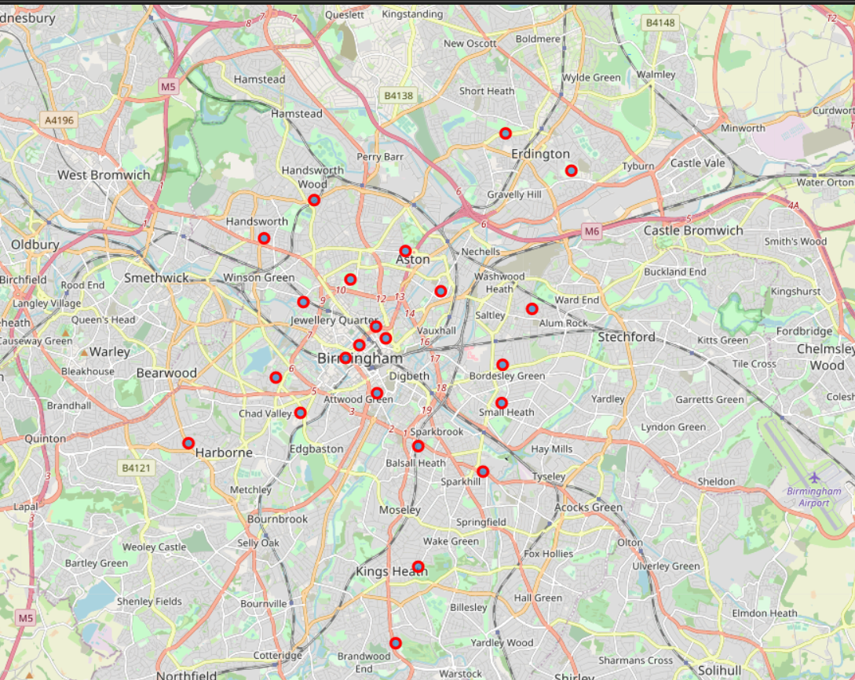
Data Visualization
The data was plotted to be visualized on map.
Blue circle marks show the postcode area districts present in East Central London
Red circle marks show the postcode area districts present in Birmingham

Slide 6
Foursquare API- Venue data
Within 500m radius of the Postcode area top 100 venues were obtained using Foursquare API for both cities.
East Central London retrieved a total of 1931 venues over the 25 districts.
There were 158 venues’ categories in East Central London from 1931 venues
Birmingham retrieved only 441 venues over the 37 districts.
There were 138 venues’ categories in Birmingham from 441 venues

Slide 7

Statistical Analysis- vENUe DATA
Mean frequency of each venues’ category was calculated to feed into machine learning algorithm

Slide 8
Machine learning
Unsupervised Learning Problem
No Labelled dataset to feed the Machine
It must find patterns from raw data itself
Best Algorithm: K-means Clustering

Slide 9
K-means clustering
Finding the optimum K value for Clustering
Two known methods:
Elbow Method
Average Silhouette Method

Slide 10
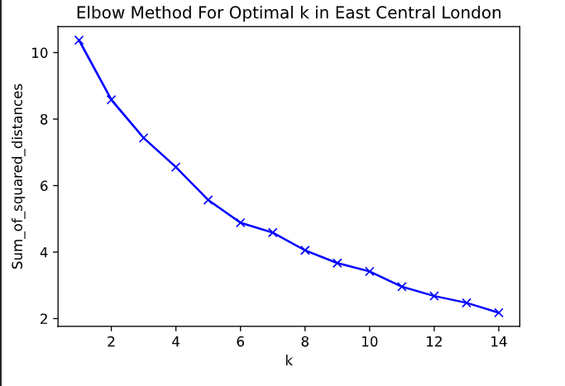
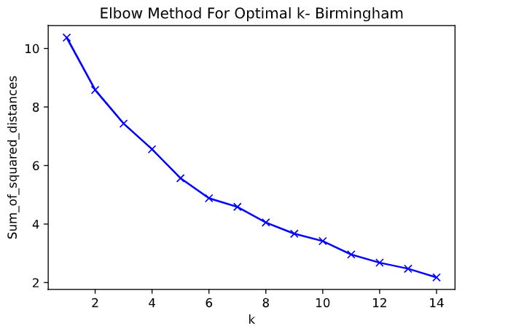
ELBOW METHOD
In Both East Central London and Birmingham, no Elbow is shown.
Further Analysis with Average Silhouette method should suffice the optimum value of K.

Slide 11
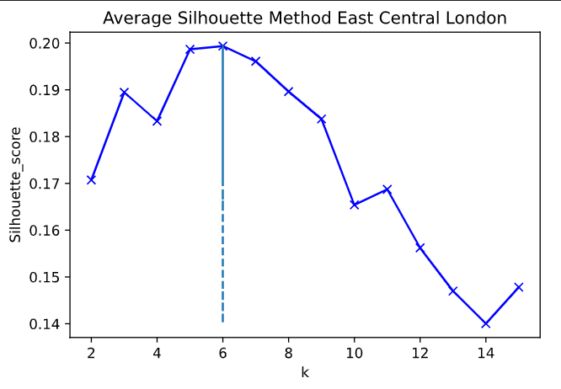
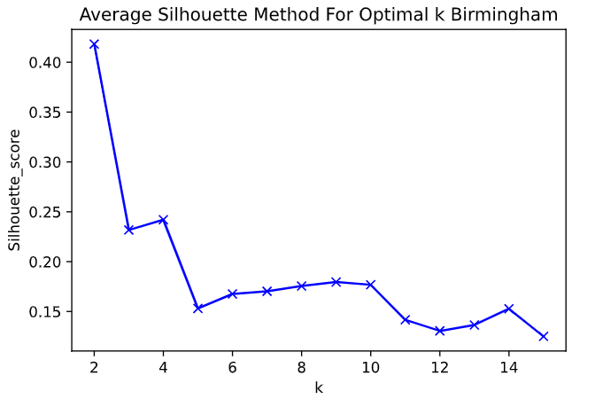
Average Silhouette method
Optimum K value for East Central London is 6
Optimum K value for Birmingham is 2.

Slide 12
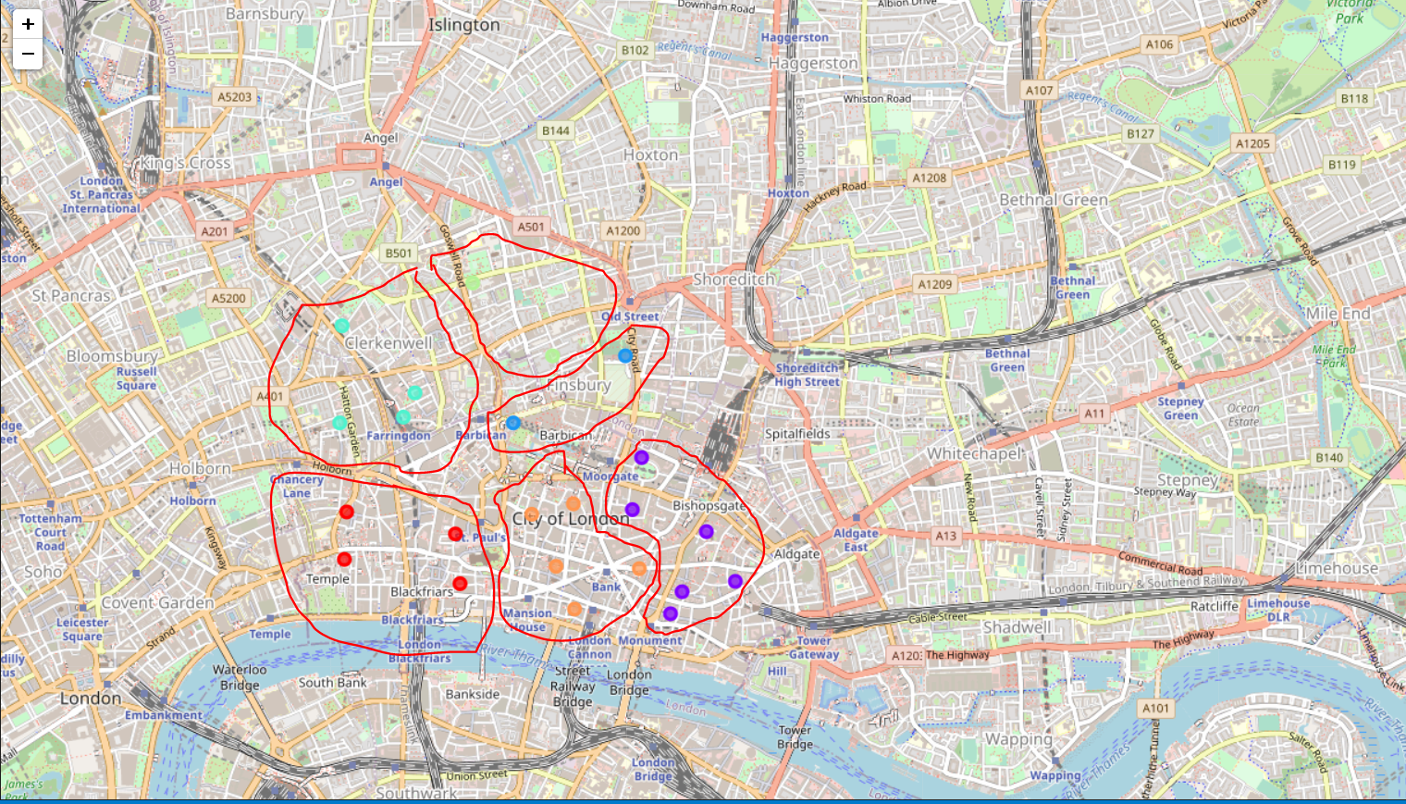
East Central London Cluster Visualization

Slide 13
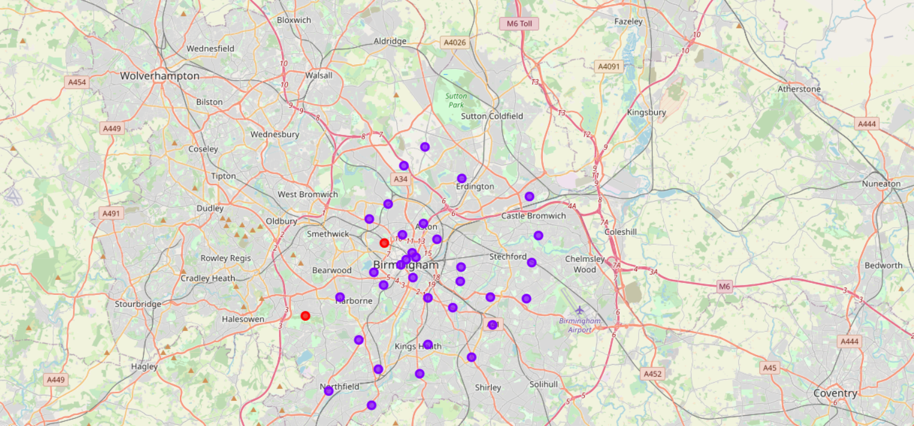
Birmingham Cluster visualization

Slide 14
East Central London Cluster Results
Cluster Number | Cluster Name
1 | Restaurant Venues- Variety of Foods
2 | Hotels and Tourists Necessities
3 | Common Residential Venues
4 | Common Residential Venues
5 | Fast food Venues
6 | Tourist Attraction

Slide 15
Birmingham Cluster Results
Cluster Number | Cluster Name
1 | Construction, Landscaping & Stadium
2 | Common Residential Necessities & Venues

Slide 16
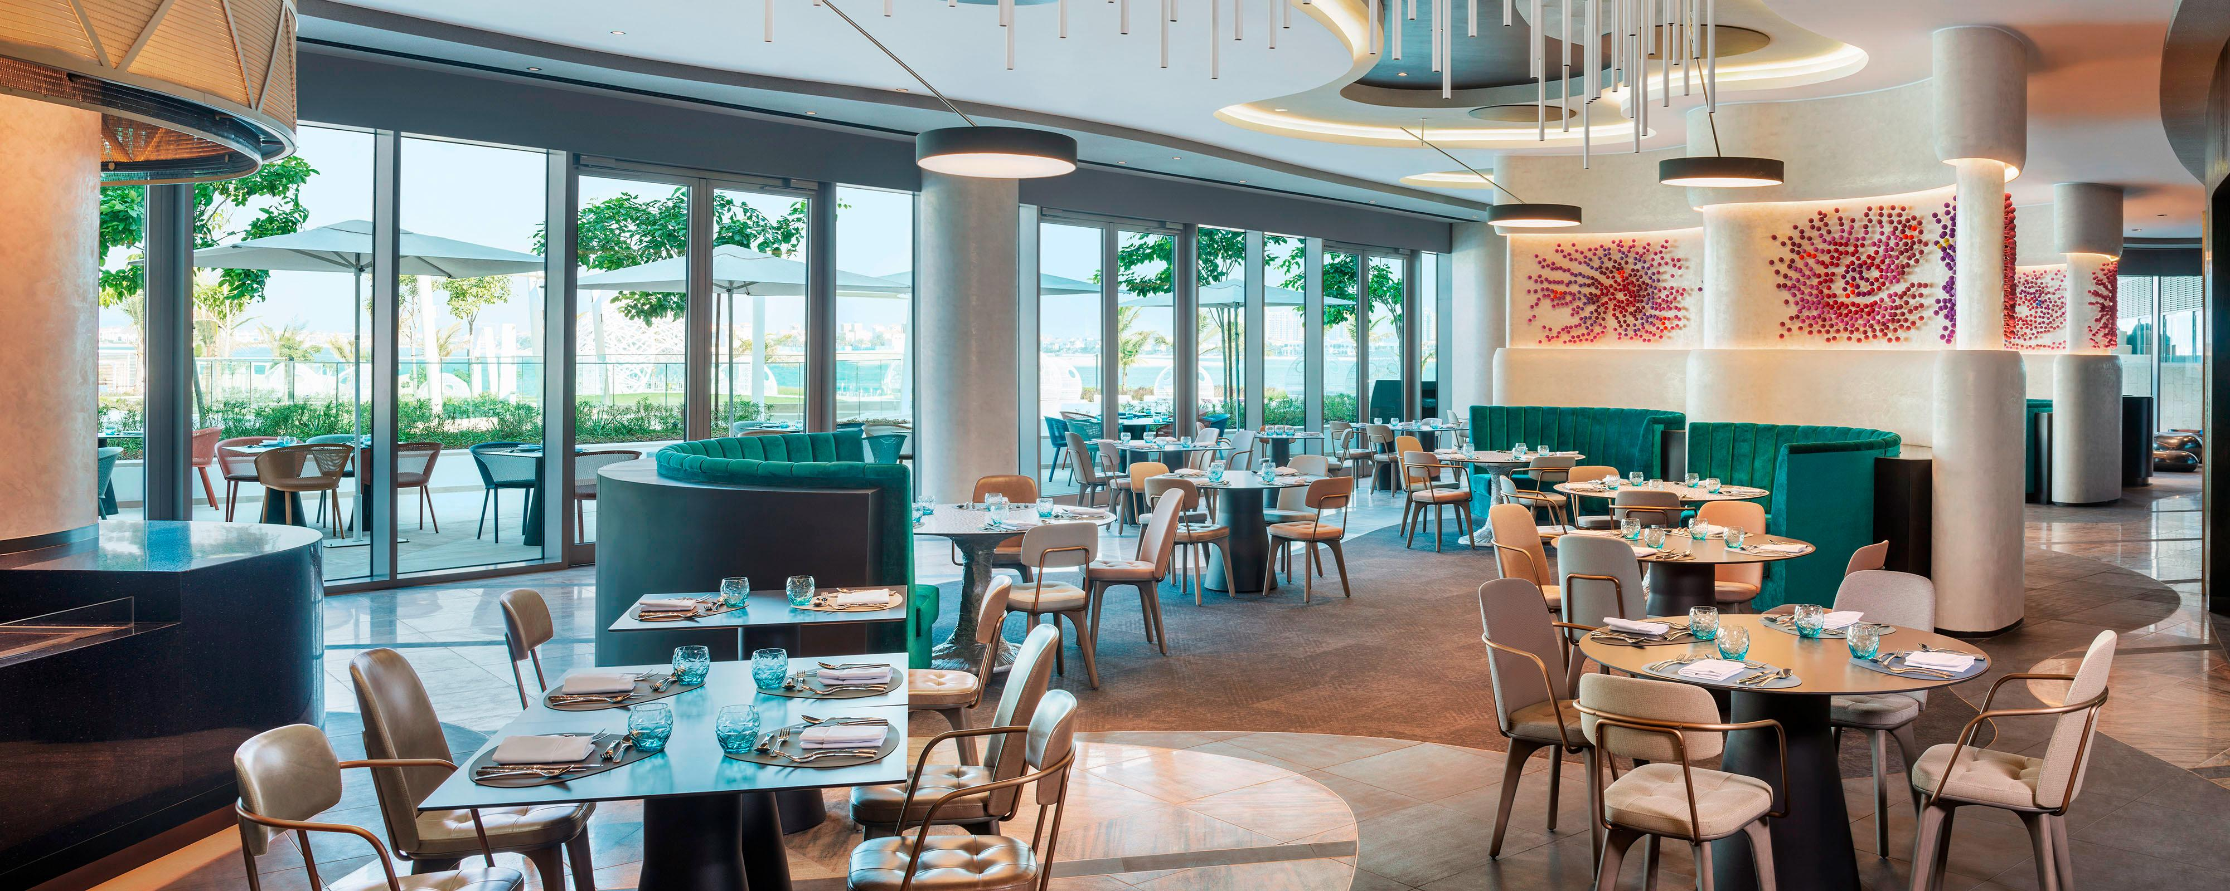
East Central London- discussion
If you are a foodie and want to go to a location for variety of Foods pick Cluster 1 as it consists of all the different foods present in the world.
New Restaurant openings in Cluster 6 can be very beneficial as most Tourists visit this Cluster on occasional Basis
Opening Restaurant in Cluster 1 would be a high-risk high reward as it has plenty of competitions as well as its prime location for food.

Slide 17
Birmingham- Discussion
Large corporation looking to expand into Birmingham, they should pick near Cluster 1
It’s more spacious area.
I would suggest picking near Winson Green as its to outskirts of Birmingham yet close enough to having access to residential needs.
Employees can stay at near Lozells to fulfil their Residential Necessities.

Slide 18

City to City Discussion
Residents living in Cluster 1 of Birmingham will prefer living in Cluster 3 and 4 as the venues and infrastructure are similar
Residents living in more open area of Birmingham i.e. Cluster 2 would prefer moving around Cluster 1 of East Central London as it is the least busy of the rest of the Clusters.

Slide 19
Conclusion
Successfully used venues’ categories data to form cluster inside cities
Differentiated and Labelled clusters by looking at the top 10 venues categories.
Compared city to city venues categories and clusters

Slide 20
Further recommendation
Use Restaurants revenue data per district to calculate the level of competition in Cluster 1 (For Entrepreneurs, Business Owners and Investors)
1
Use Ethnic Diversity data per district to check the community
( For Job seeker, Job shifting)
2
Use Skillset Diversity data to check skillset of area
( For Large Corporations)
3

Slide 21


